Slide 1
Windows 10 Module 6
Customizing Windows

Slide 2
Module Objectives
  View Windows settings
  Personalize the desktop, theme, and lock screen
  Change user account settings
  Change notification settings
  Change Cortana and search settings
  Change general settings
  Change share and privacy settings
  Use the Control Panel

Slide 3
View Windows Settings (Slide 1 of 2)
Settings app
  Use Start menu to access
  Nine touch-friendly categories of most commonly used Windows options
    Examples are Personalization settings and Time & language settings
    Other settings located in Control Panel, a desktop app
  Overlap between Settings app and Control Panel
    Use Control Panel for more advanced settings
    Use Cortana to search for appropriate app

Slide 4
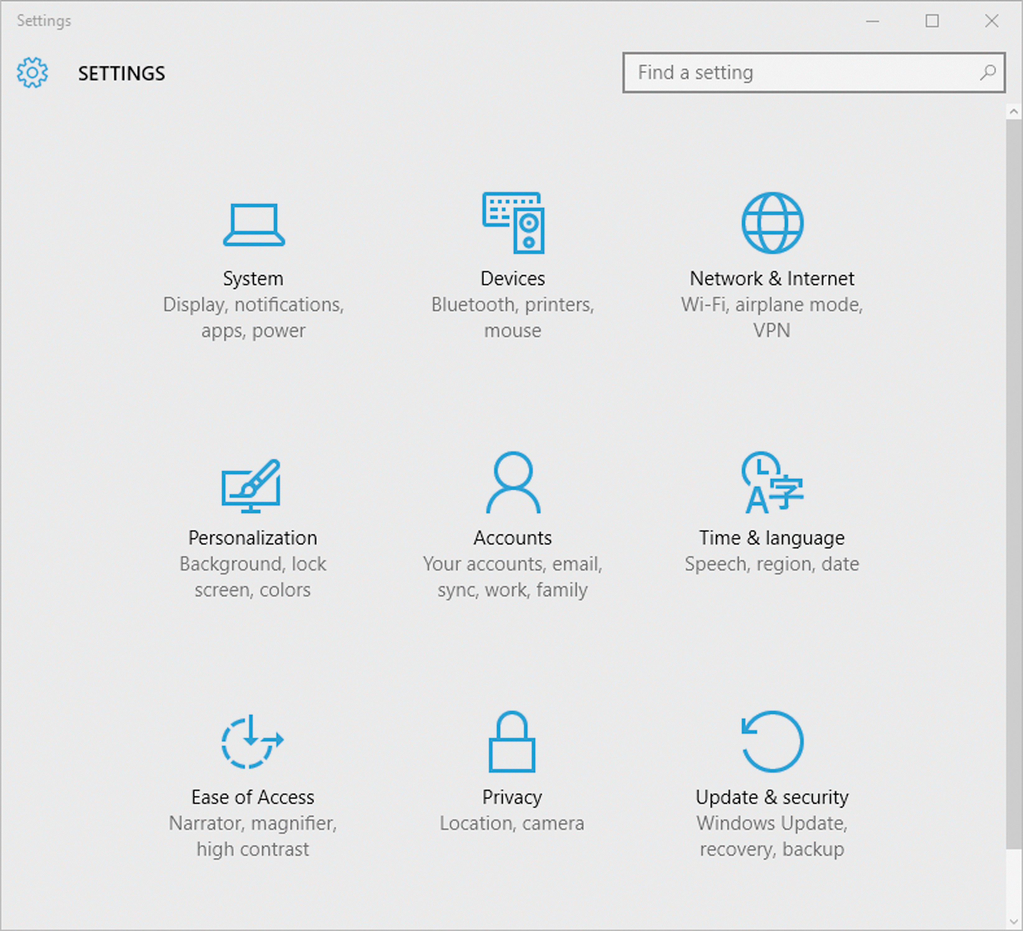
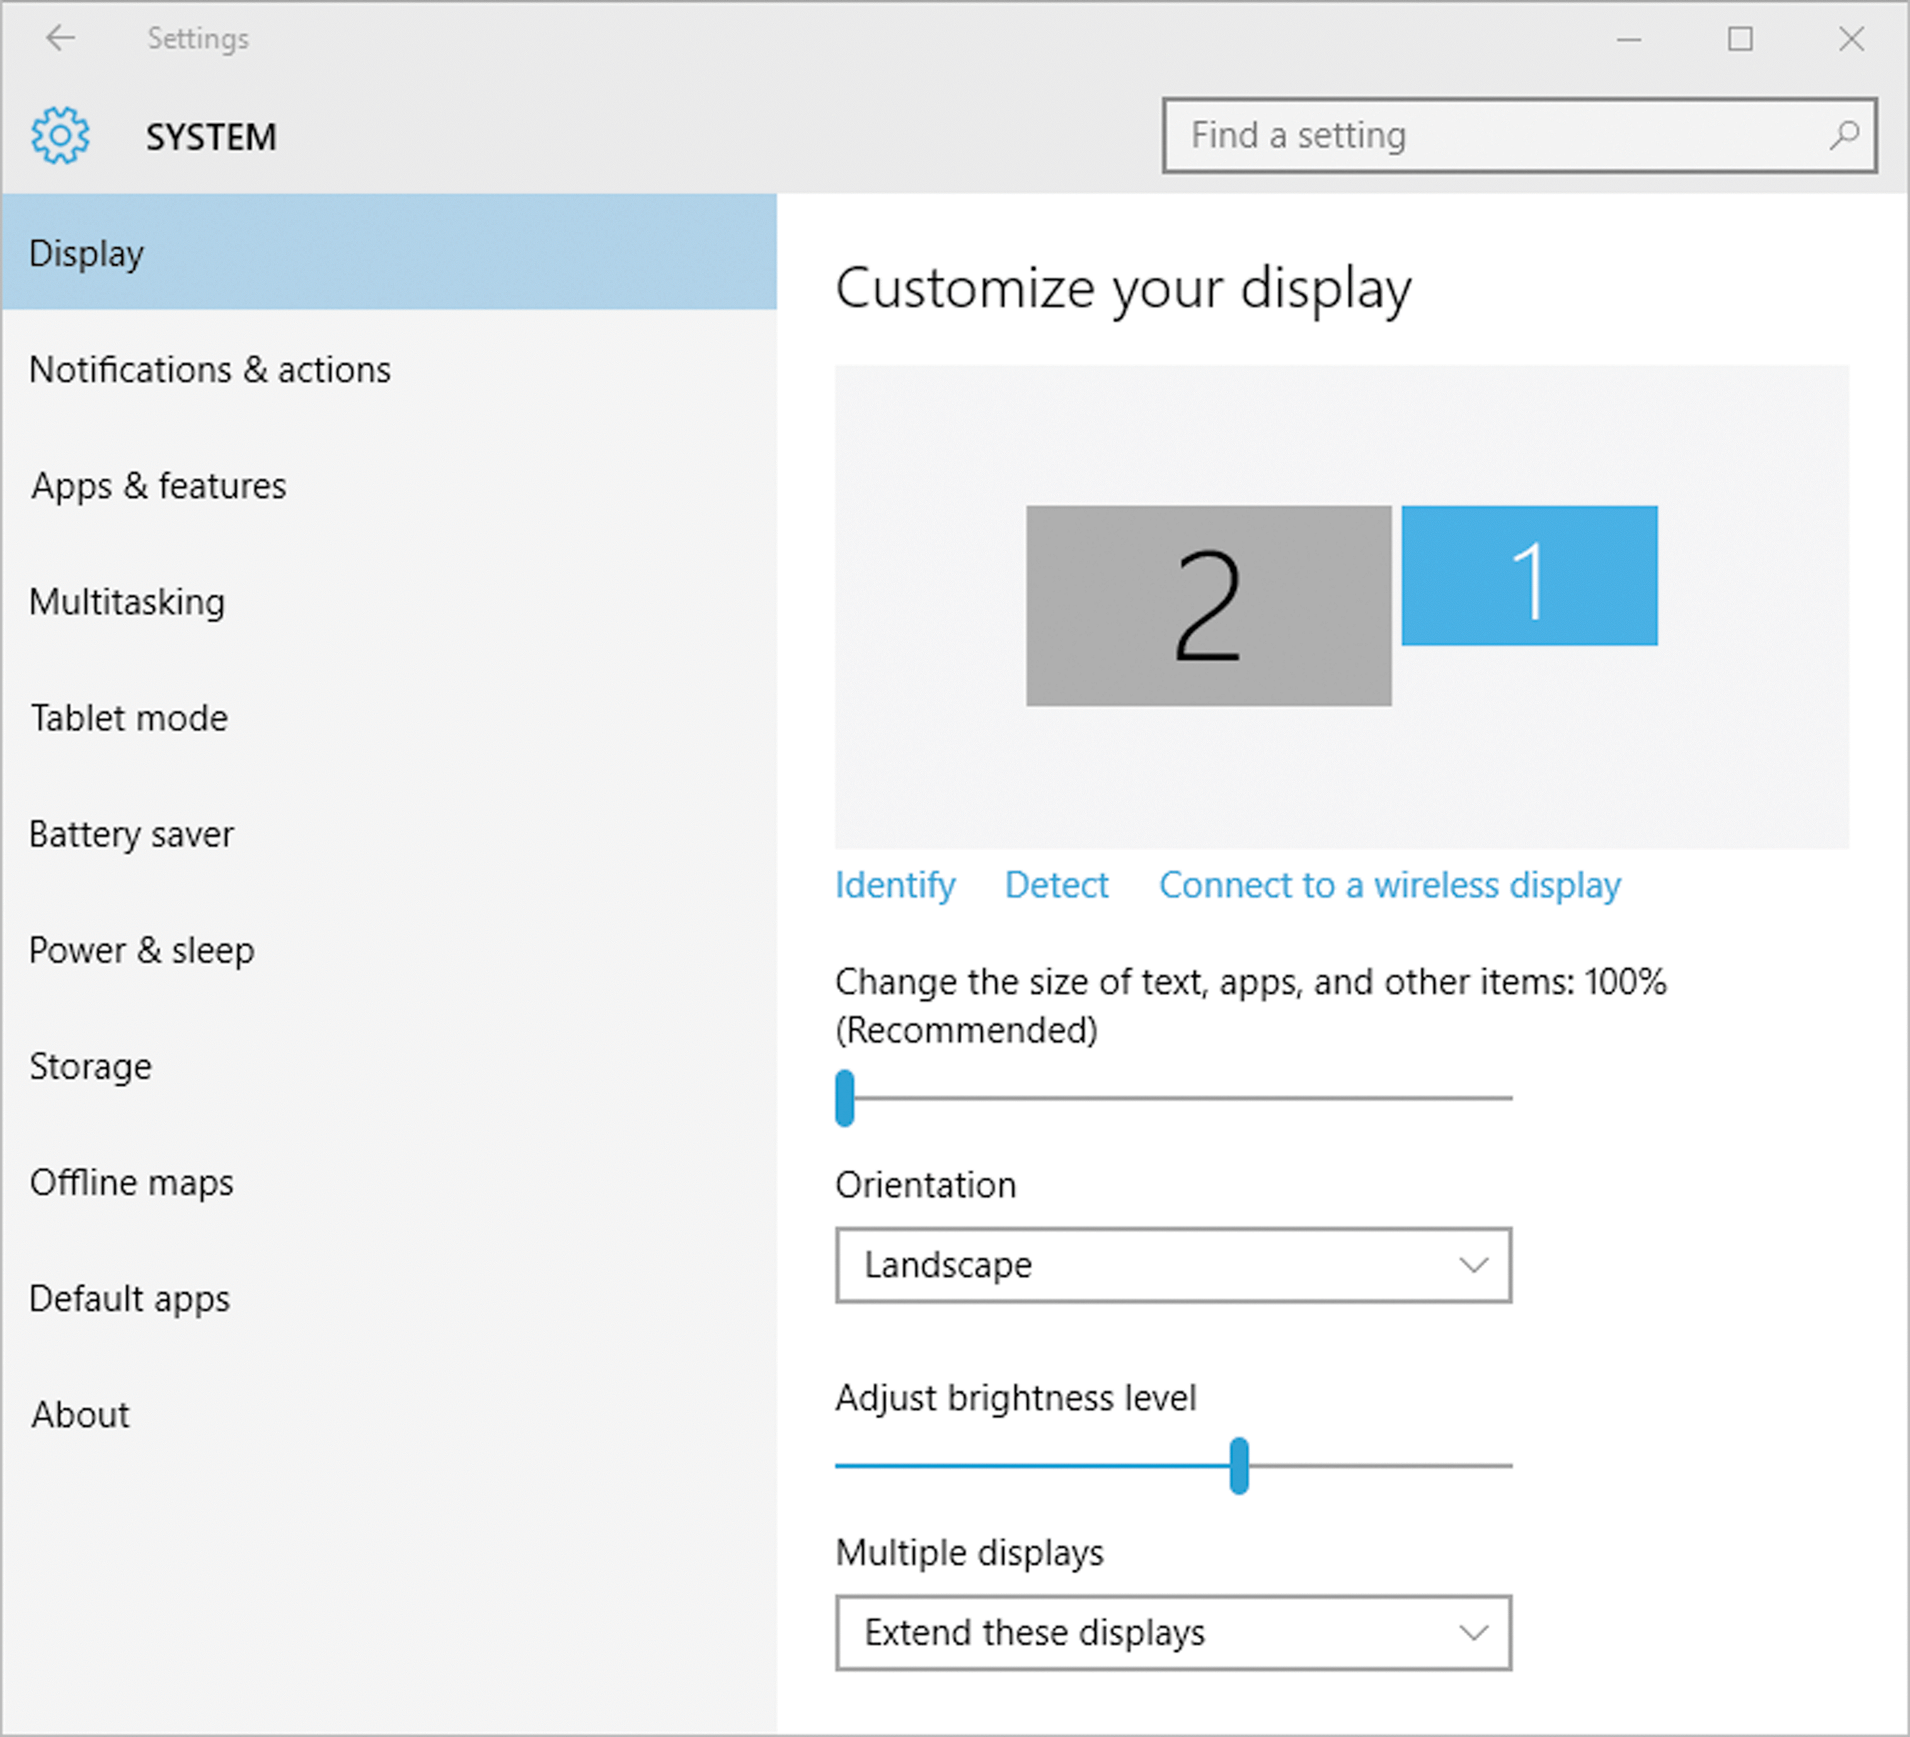
View Windows Settings (Slide 2 of 2)
Settings app categories
System settings subcategory

Slide 5
Personalize the Desktop, Theme, and Lock Screen (Slide 1 of 2)
Can use Settings app to customize desktop
  Change color
  Change picture
    Group pictures in a slideshow
  Can change theme for desktop and Windows colors, fonts, and sounds
  Can customize the Lock screen
Use Personalization category in Settings app
Can add Lock screen apps to view status information and notifications without having to unlock system

Slide 6
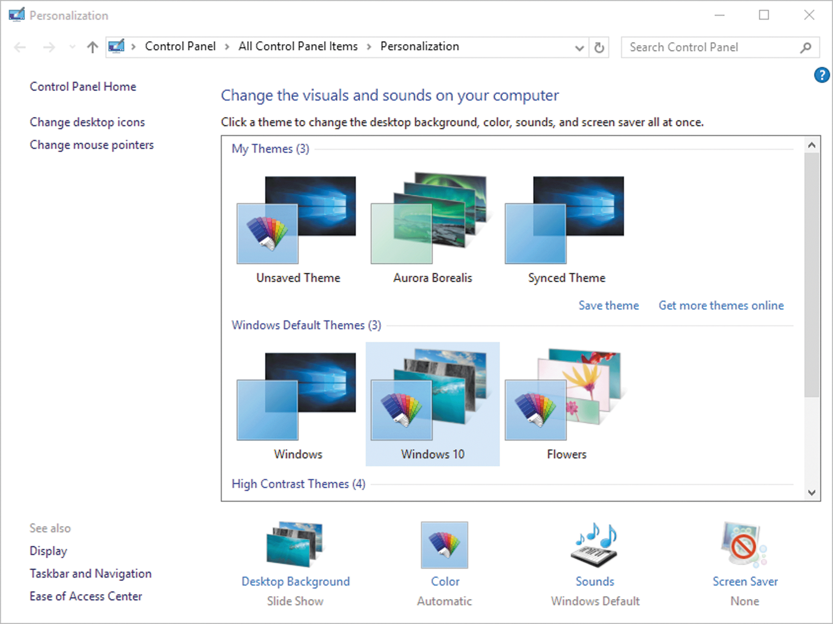
Personalize the Desktop, Theme, and Lock Screen (Slide 2 of 2)
Windows 10 Theme characteristics

Slide 7
Change User Account Settings (Slide 1 of 2)
Use Accounts category of the Settings app
  Can change your sign-in password and other account settings
Can manage your account online or change it to a local one
Administrators can create a new user account with a separate identity
  Also delete accounts
In Windows 10, you can use multiple security passwords or codes, such as text or pictures
  Use gestures with picture passwords
  Can use four-digit PIN (Personal Identification Number)

Slide 8
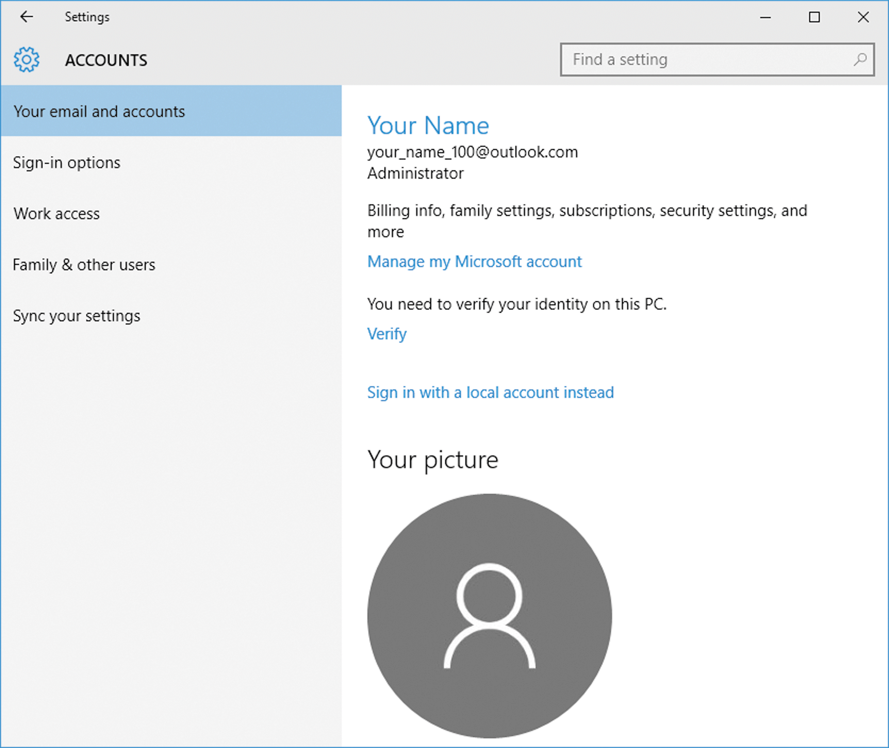
Change User Account Settings (Slide 2 of 2)
Email and accounts settings

Slide 9
Change Notification Settings (Slide 1 of 2)
Windows 10 communicates with you through notifications
Types of notifications
  Pop-up message
  Quick action button
  System icons
Change notification settings under Notifications & actions subcategory in System category of Settings app

Slide 10
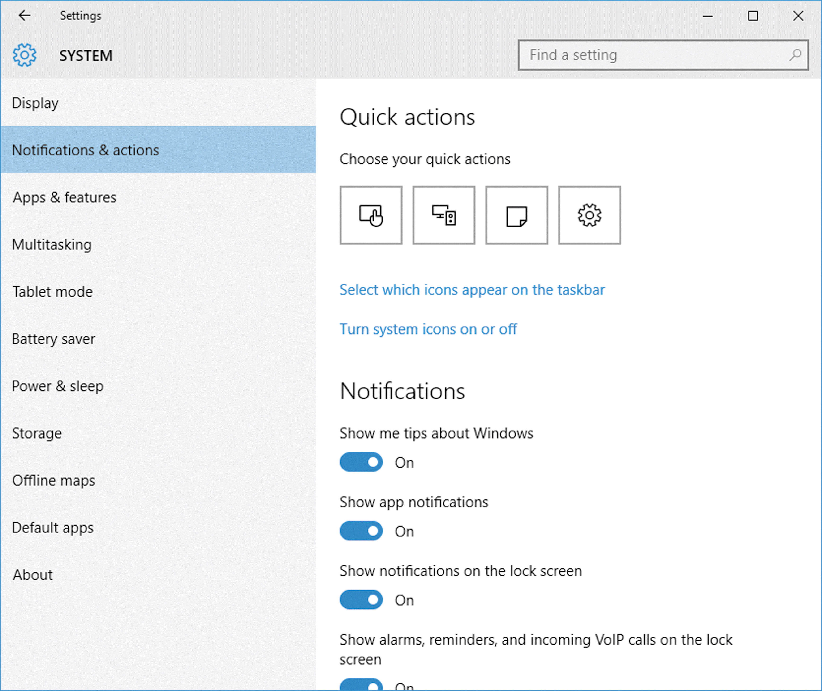
Change Notification Settings (Slide 2 of 2)
Notifications & actions settings

Slide 11
Change Cortana and Search Settings (Slide 1 of 2)
Cortana
  Monitors and “learn” information
  Stores information in its Notebook
  Presents you with information cards when you open Cortana menu
Can clear search history
Can customize Cortana to display information in a certain category, such as Academic

Slide 12
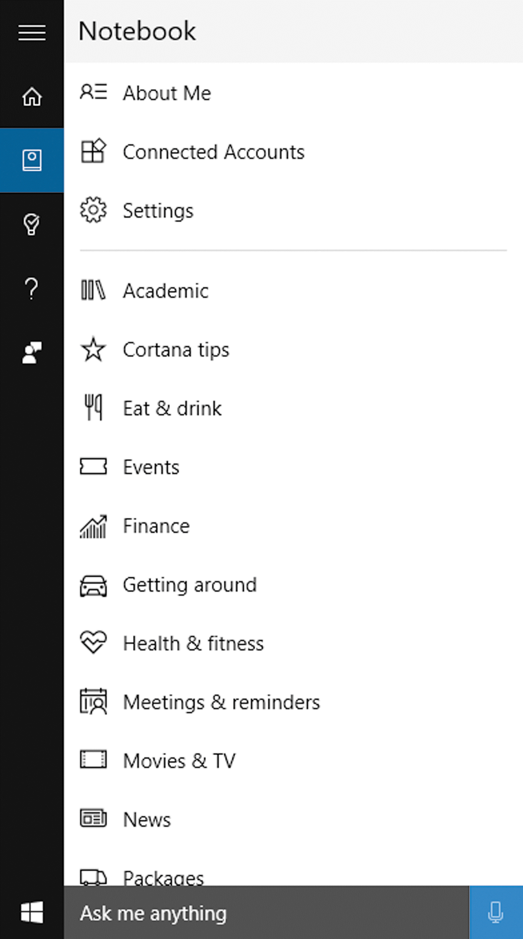
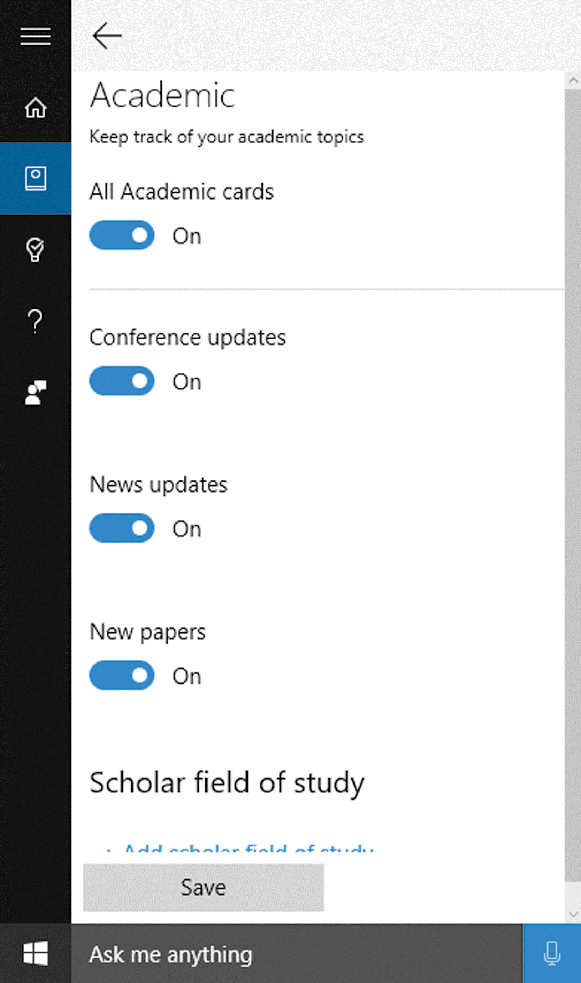
Change Cortana and Search Settings (Slide 2 of 2)
Cortana Notebook
Academic area of Notebook

Slide 13
Change General Settings (Slide 1 of 2)
General information that affects computer’s performance, such as
  Date & Time
  Apps installed
  Amount of memory and available storage
Can set options to refresh, or reinstall Windows 10
Found in the Systems category in the Settings app

Slide 14
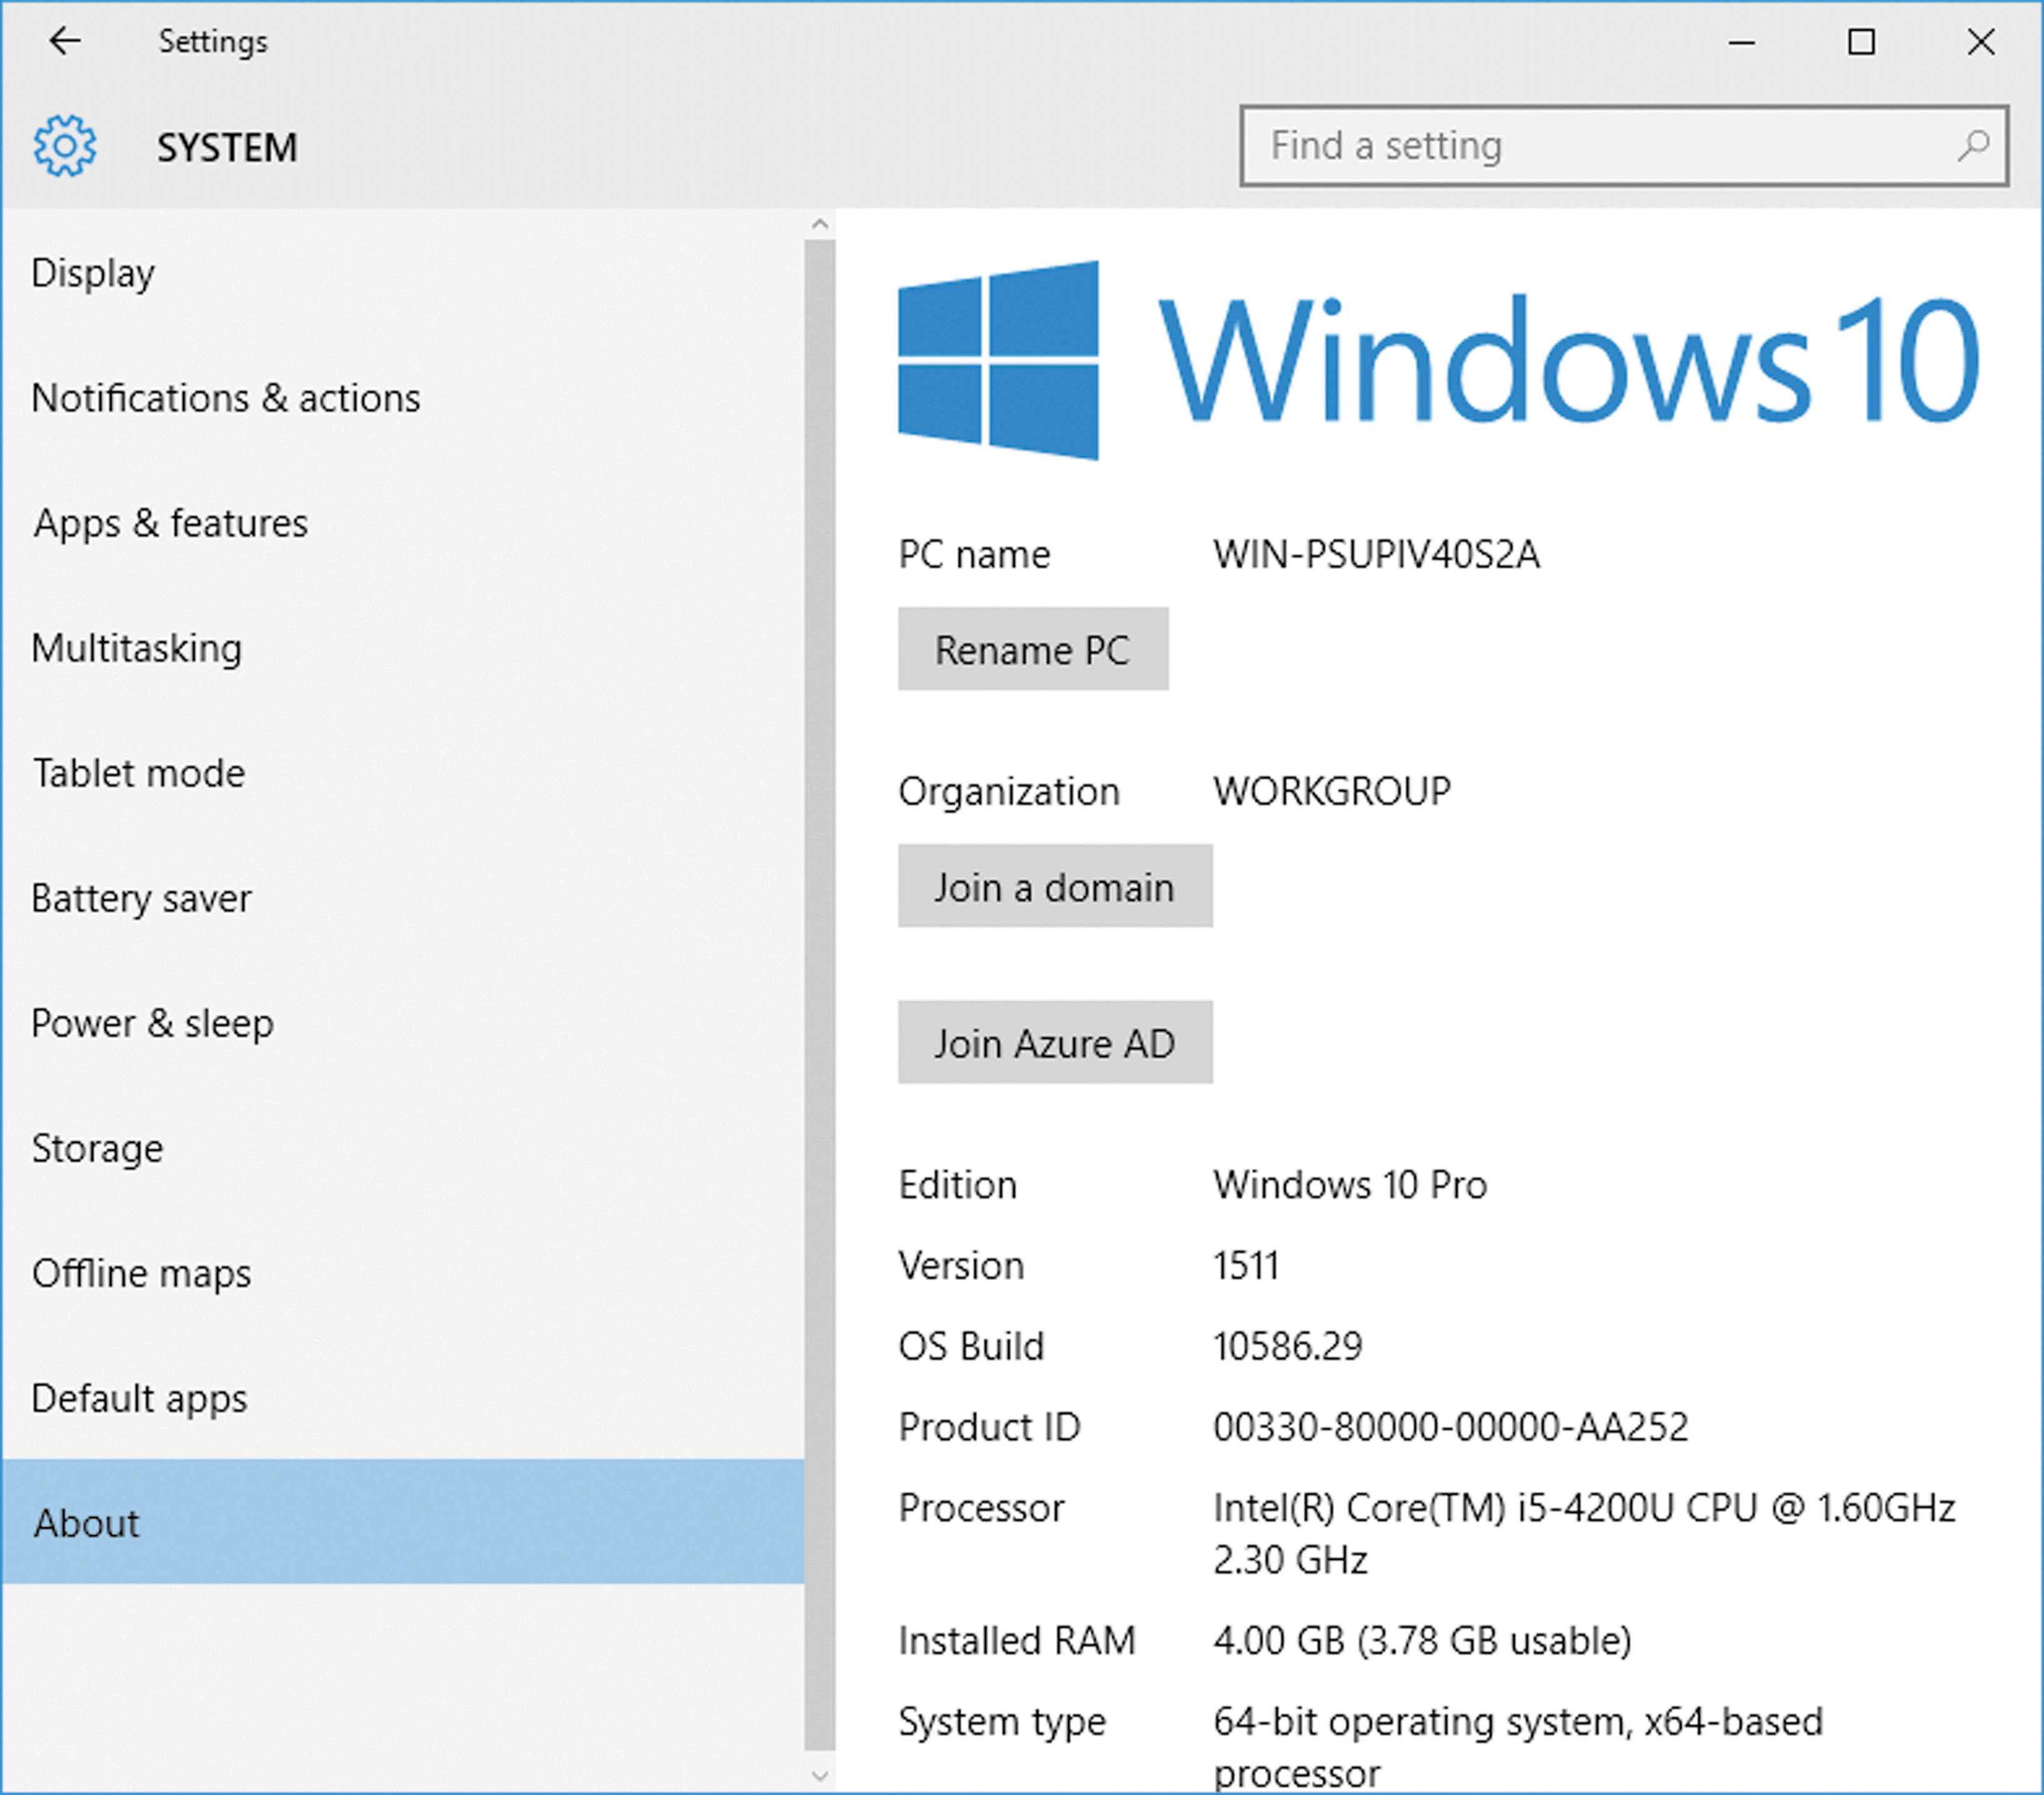
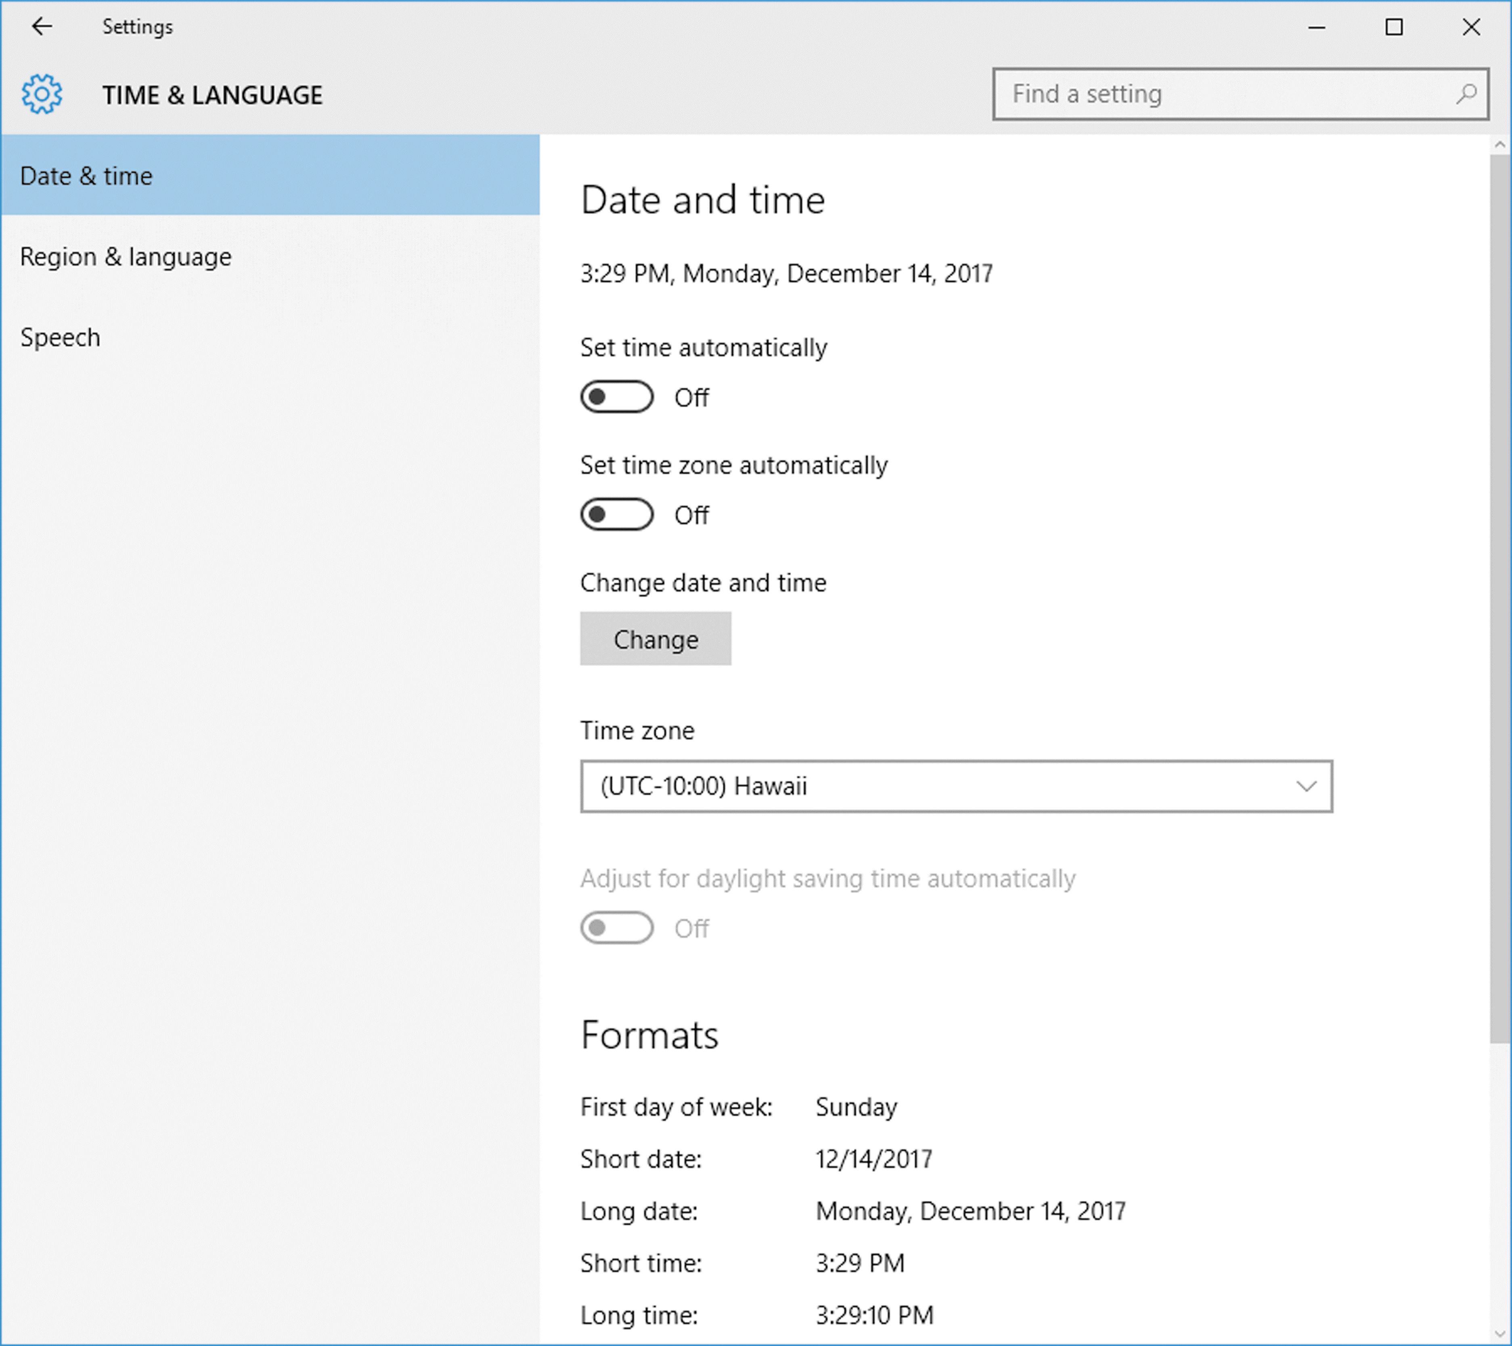
Change General Settings (Slide 2 of 2)
Computer system information
Date and time settings

Slide 15
Change Share and Privacy Settings
Use Privacy category in Settings app
  Enable or disable the use of current location in apps such as Maps
  Enable or disable display of account name and picture during instant messaging
Also can determine sharing within a specific app
Can turn off personalized ads in browser

Slide 16
Use the Control Panel (Slide 1 of 2)
Control Panel contains more advanced or less frequently used settings in Windows 10
  Useful collection of utilities for use with Windows
  May contain small applications called applets
  Question series called wizards
Can customize desktop icons
  Right-click or tap and hold a blank area on desktop and click to tap Personalization

Slide 17
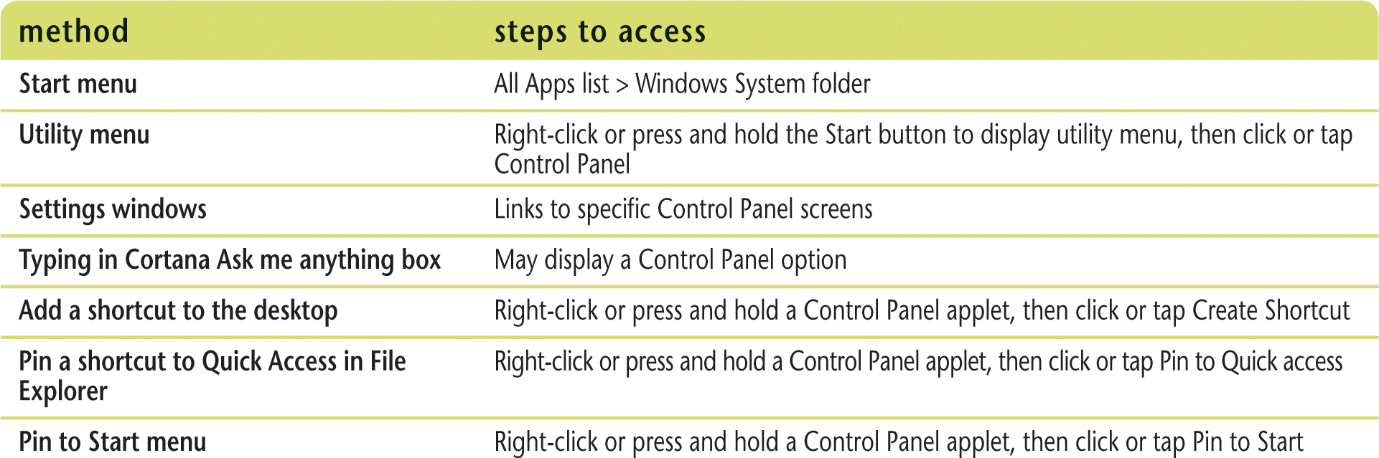
Use the Control Panel (Slide 2 of 2)
Ways to access Control Panel options

